Slide 1


dCloud
ECSE205L - Spring 2020
A Dectralized Cloud
Aachman Garg
Anudit Nagar
Vinayak Tiwari
E18CSE001
E18CSE024
E18CSE211

Slide 2
Abstract

Slide 3




Abstract
FAULT TOLERANT
SCALABLE
PRIVATE
SECURE
Decentralised alternative to AWS

Slide 4
The Problem

Slide 5
The Problem
Only few companies dominate the Internet

Slide 6
The Problem
Only few companies dominate the Internet
They store, use and control users’ personal data

Slide 7
The Problem
They store, use and control users’ personal data
Gives centralized entities unfair advantage

Slide 8
The Solution

Slide 9
The Solution
A distributed cloud backed by Ethereum that can store and compute data through a network of micro devices.

Slide 10
Project Setup

Slide 11





Project Setup
Global Coordinator acting as an intermediary relayer
Desktop and
Web App
Containerization and Execution of Applications on a remote node.
Maintaining the DHT and Incentivisation mechanisms
Mobile App

Slide 12
Stakeholders

Slide 13
Stakeholders
Development
Team
Users
dCloud
Project
Developers
Mentors

Slide 14
Users

Slide 15
Users
Platform Users
Platform Developers
These are people who will access and use the applications that are deployed on dCloud
These are people who will deploy their applications on top of dCloud to make them accessible by the public

Slide 16
User Stories

Slide 17
User Stories
ID | Added | Description | Status | Story Points | Actual Equivalent Story Points | % Completed
100 | onset | Be able to login/logout in the application | C | 1 | 1 | 100
100 | Onset | Be able to fetch the user data from the profile | C | 1 | 1 | 100
Acceptance Criteria |  |  | Verification
110 | The user must have appropriate ID and password |  | The password is encrypted and set to the backend for verification
111 | ID should automatically logged out after 1 hr of idle time |  | The user session is expired if the site is left open for too long with no activity to ensure security
Id | Tasks |  |  | Resources
1 | Fetch the correct API tokens for login |  |  | Anudit Nagar
2 | Create a login interface for the user to be able to Input Credentials |  |  | Aachman Garg
3 | Check and maintain user credentials |  |  | Vinayak
Sprint 1

Slide 18
User Stories
ID | Added | Description | Status | Story Points | Actual Equivalent Story Points | % Completed
200 | onset | As an user I must be able to connect and import various code sources like GitHub and GitLab | C | 2 | 2 | 100
200 | Onset | As an user, I should be able to access my connected repositories | C | 3 | 3 | 100
Acceptance Criteria |  |  | Verification
211 | The user must have Github/GitLab account and be able to allow access to the code. |  | The user is able to connect their account and import code.
212 | The accessible code should be checked before deploying |  | The imported code is correctly compiled and checked before deploying.
Id | Tasks |  |  | Resources
1 | Maintain Auth Tokens and |  |  | Anudit Nagar
2 | Maintain User’s codebase internally |  |  | Anudit Nagar
3 | Create a front end for the user to be able to access and import code |  |  | Aachman Garg
4 | Maintain records of builds and build logs |  |  | Vinayak Tiwari
Sprint 2

Slide 19
User Stories
ID | Added | Description | Status | Story Points | Actual Equivalent Story Points | % Completed
300 | onset | As an user I must be able to create and host the application | C | 7 | 7 | 100
311 | onset | The application should be containerized and deployed | C | 8 | 8 | 100
Acceptance Criteria |  |  | Verification
311 | The created application should be compiled and sent to the backend |  | The application is configured correctly, compiled and sent to the backend for propagation.
312 | The compiled application is then containerized and distributed to the network. |  | The application is packaged, containerized and sent to the required nodes in the network
Id | Tasks |  |  | Resources
1 | Create a front end for the user to be able to discover/access the application |  |  | Aachman Garg
2 | Compile, Package and Containerize the Applications |  |  | Anudit Nagar
3 | Find a suitable node in the network and send the application to it to run |  |  | Anudit Nagar
4 | Maintain record of active nodes over DHT |  |  | Vinayak
Sprint 3

Slide 20
User Stories
ID | Added | Description | Status | Story Points | Actual Equivalent Story Points | % Completed
400 | Onset | As a User of platform, I want to be able to access the applications deployed on it on my phone. | C | 4 | 4 | 100%
401 | Onset | As a User of platform, The deployed applications should be accessible via a URL on my computer. | C | 4 | 4 | 100%
Acceptance Criteria |  |  | Verification
400 | When the page is visited the application should load correctly. |  | The url link is open on a browser on Mobile and Computer to verify if the site loads correctly.
401 | The URL should point to the correct application. |  | When the application loads it should be the one that was intended to open.
Id | Tasks |  |  | Resources
1 | Setup DNS over DHT and make the url point the application. |  |  | Anudit Nagar
2 | Create a front end for the user to be able to discover/access the application |  |  | Aachman Garg
3 | Maintain and update DHT over blockchain |  |  | Vinayak Tiwari
Sprint 4

Slide 21
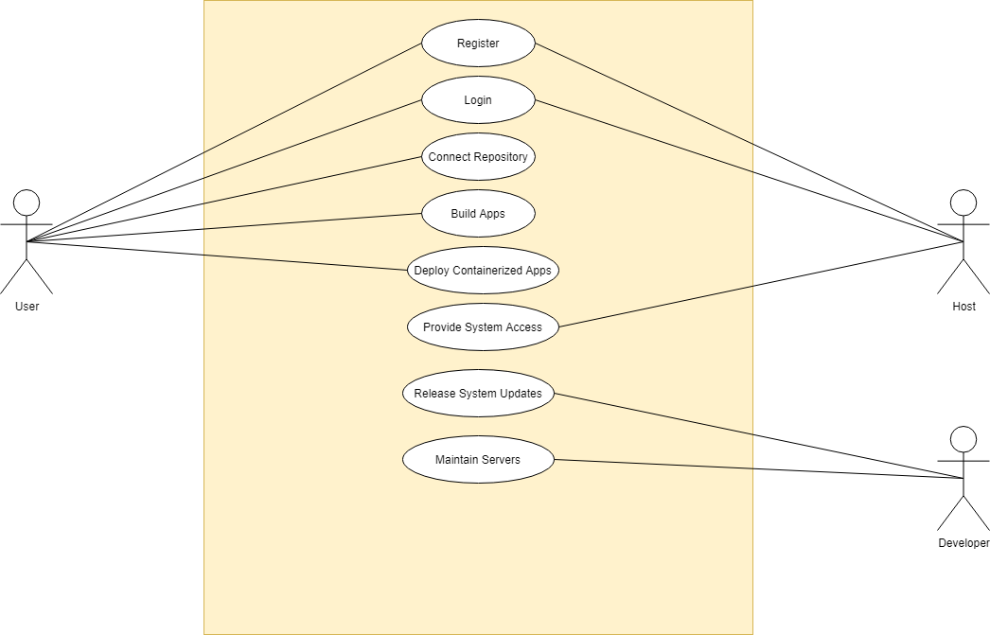
Use
Case
Diagram

Slide 22
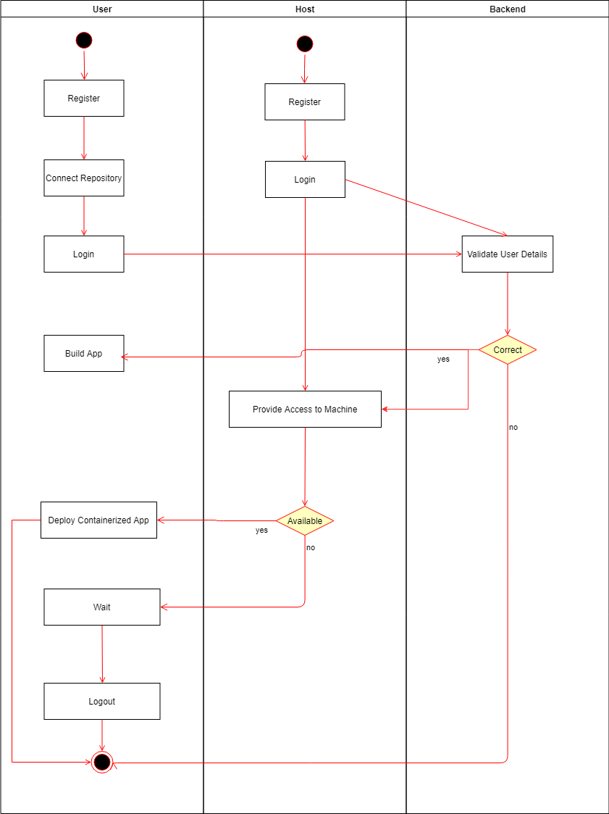
Activity
Diagram

Slide 23
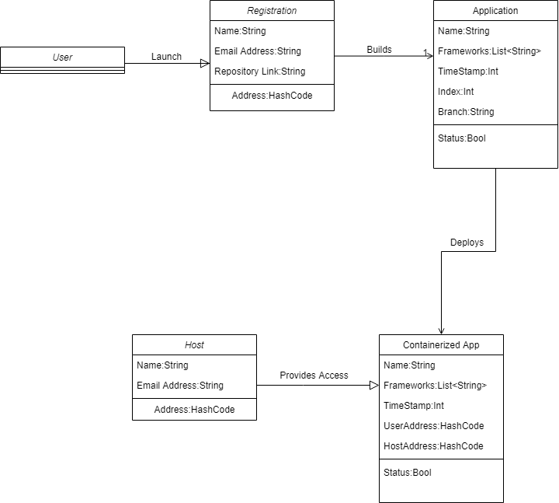
Class
Diagram

Slide 24
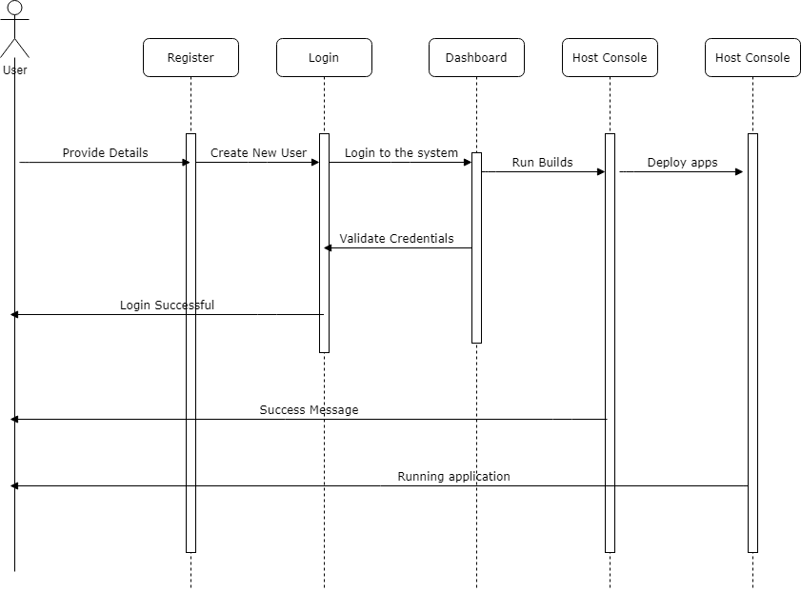
Sequence
Diagram

Slide 25
Thank You !

